Slide 1

Crowdcount : People Counting and Zone Management System
Presented By: Team 2.
Yogendra
shanmukh
Jyoshna
shanta
VALALND PARTH
dhruvil
Mentor: Umme Asma s.
Training Duration: 22/09/2025 – 21/11/2025
Notes:
1

Slide 2


Project Introduction:
Public spaces like malls, airports, and parks often require real-time people counting for security, analytics, and operational efficiency. This project aims to automate people counting using a live camera feed, leveraging computer vision and deep learning. The system will detect and count people in a video stream with high accuracy and provide live analytics through an interactive dashboard. It will support multiple zones and ensure smooth performance with real-time processing.
Notes:
2

Slide 3

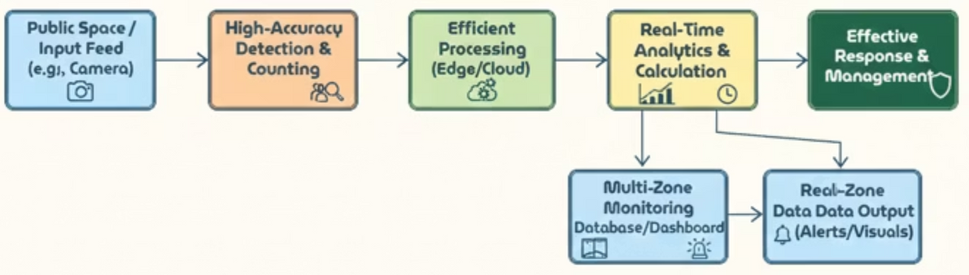
The Challenge: Bridging the Gap in Crowd Monitoring
System Workflow Summary
This system processes live camera input to detect and count people accurately. The data is then processed on edge or cloud systems, where real-time analytics are performed. The results feed into a dashboard for monitoring multiple zones, and alerts or visuals are generated instantly. This helps ensure effective response and better crowd management.
Notes:
3

Slide 4
Key Objectives: Building a Robust Solution
Our project is structured around clear objectives designed to deliver a comprehensive and effective crowd management system:
1
2
3
Automated Real-Time People Counting
Accurate Deep Learning Detection
Interactive Live Analytics Dashboard
Develop a system for continuous, automated people counting from live camera feeds.
Implement YOLOv8 (You Only Look Once) for precise individual detection and tracking.
Provide a user-friendly dashboard for visualizing real-time crowd data and trends.
4
5
Zone Occupancy & Alerts
Low-Latency & Secure Access
Track occupancy across various zones and trigger automated alerts based on predefined thresholds.
Ensure rapid data processing and secure, user-friendly access to the system.
Notes:
4

Slide 5






Technology Stack: Powering the System
A diverse set of cutting-edge tools and libraries forms the backbone of our People Counting and Zone Management System, ensuring robustness, scalability, and efficiency.
Programming Core
Computer Vision & AI
Data Management
Data Visualization
Python, Flask, HTML, CSS, JavaScript: The primary languages and framework for backend logic, web development, and interactive front-end experiences.
OpenCV, YOLOv8, NumPy: Essential for real-time video processing, object detection, and numerical operations crucial for crowd analysis.
MySQL, Pandas: Robust databases for storing system configurations and analytics data, complemented by Pandas for data manipulation.
Matplotlib helps us show data using line charts, bar charts, and trend graphs for clear visualization.
Development Environment
Security Protocols
VS Code: Our integrated development environment, providing a rich feature set for efficient coding and debugging.
JWT Authentication: Implementing JSON Web Tokens for secure and stateless user authentication, safeguarding access to the system.
Notes:
5

Slide 6
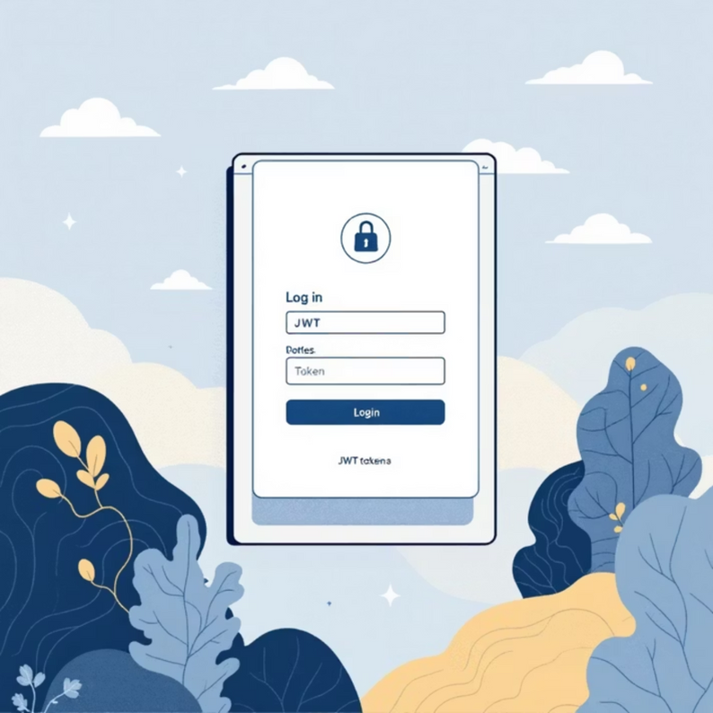
Milestone 1: Establishing the Foundation
The initial phase focused on building the core user authentication and system interface, creating a secure and accessible platform for subsequent developments.
User Authentication
1
Implemented Login and Registration functionalities, ensuring secure access.
2
Flask & Database Integration
Developed the UI using a Flask backend seamlessly connected to a chosen database.
JWT Security
3
Integrated JSON Web Token (JWT) for robust and stateless user authentication, enhancing system security.
4
Intuitive Dashboard
Designed a clear sidebar navigation including Home, Profile, and Logout options for easy user experience.
Notes:
6

Slide 7
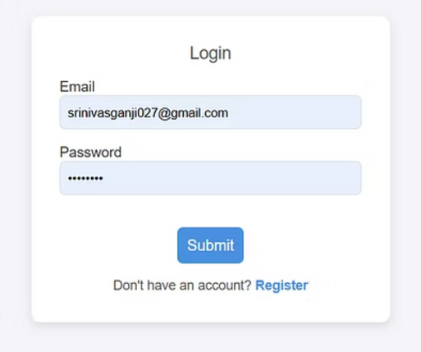
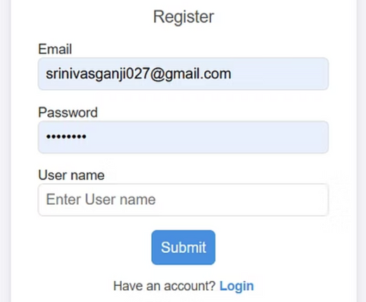
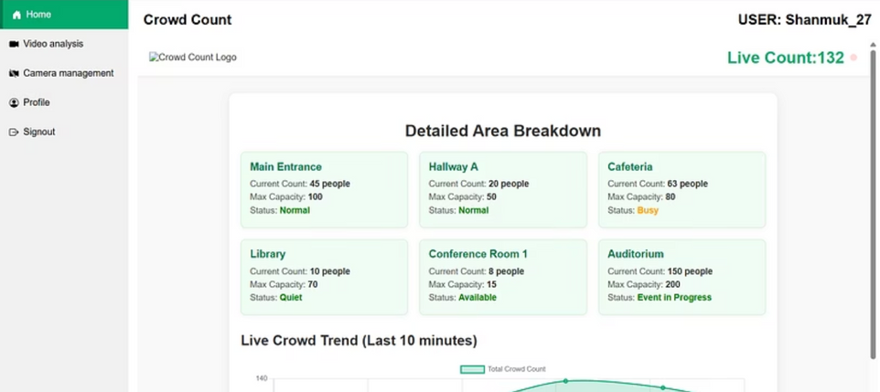
Milestone 1:
Notes:
7

Slide 8
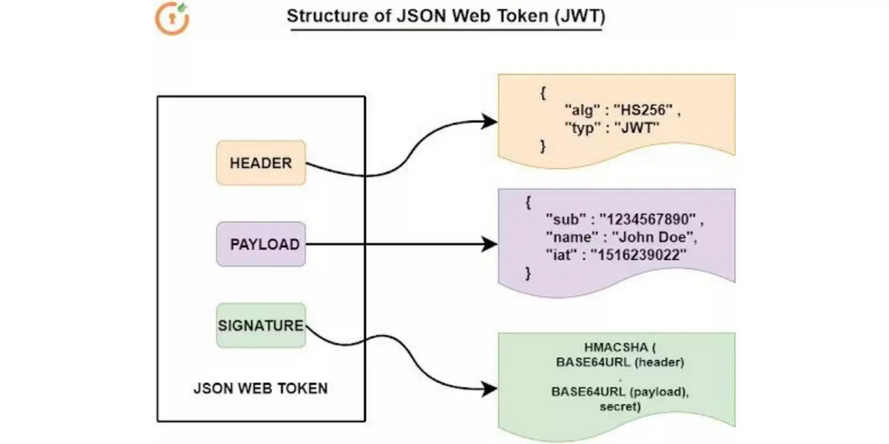
Milestone 1:
About JWT secure token:
JWT works by packaging user data into a JSON payload, combining it with a header, and then encoding both using Base64. This encoded data is then secured with a cryptographic signature using a secret key. Once generated, the token carries all authentication information by itself, making it tamper-proof and allowing the server to verify the user without storing session data.
Notes:
8

Slide 9




Milestone 2: Vision and Detection Capabilities
This milestone brought the core computer vision capabilities online, enabling the system to detect and track individuals through various input modes, a crucial step for accurate crowd monitoring.
YOLOv8 Integration
Successfully integrated YOLOv8 with OpenCV for real-time object detection, forming the intelligence of the system.
Flexible Input Modes
Configured support for Live Webcam, Image Upload, and Video Upload, catering to diverse deployment scenarios.
Visual Detection
The system now accurately displays detected people with bounding boxes, providing visual confirmation of recognition.
NumPy
NumPy helps process large arrays, perform mathematical operations, and speed up data handling.
Notes:
9

Slide 10
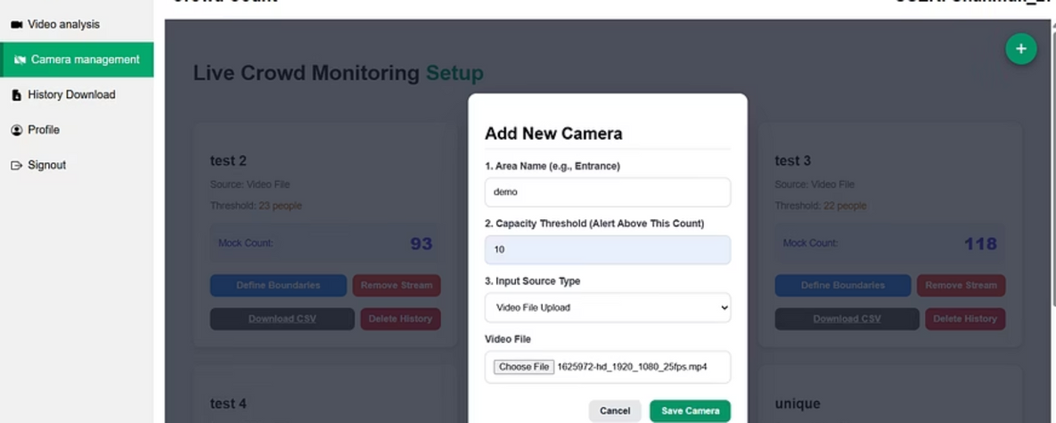
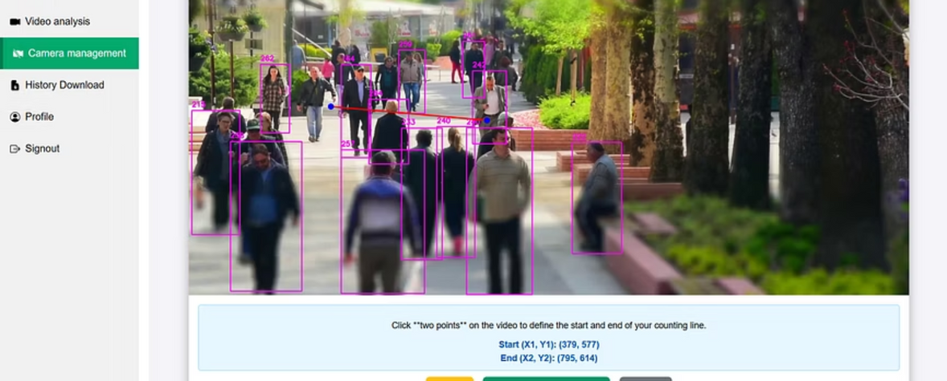
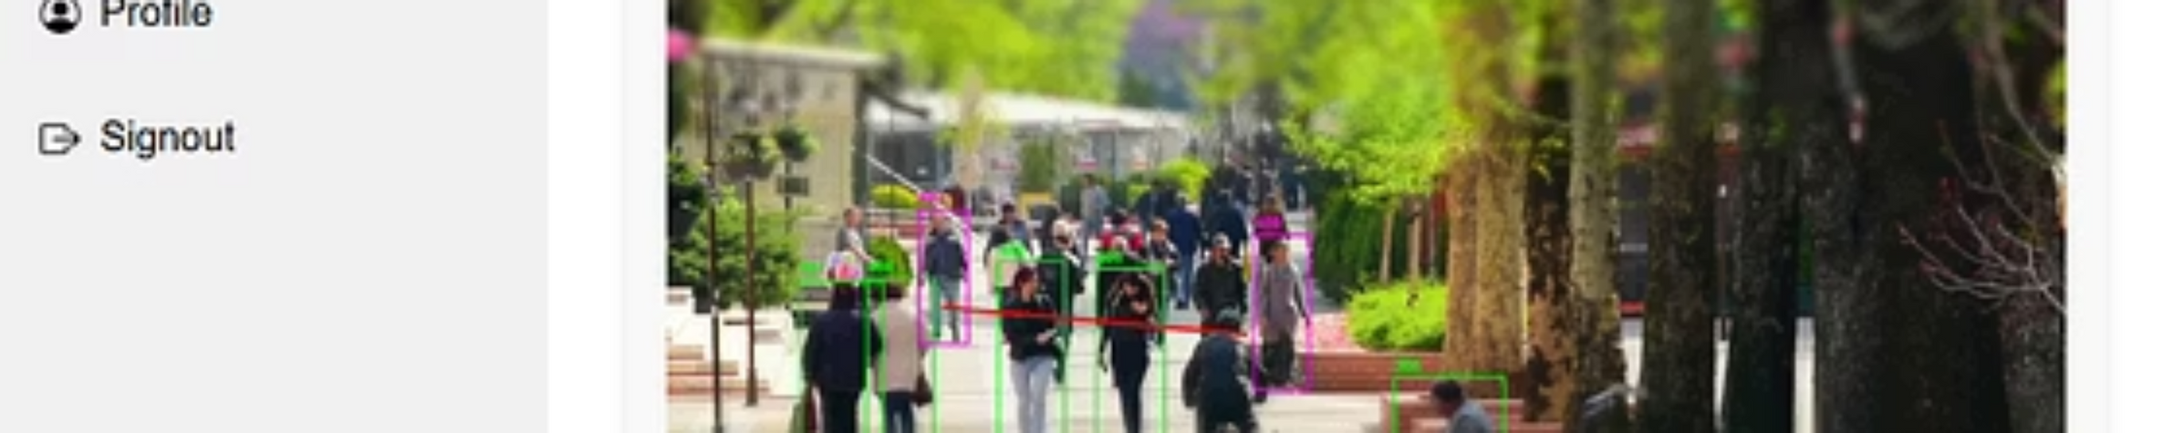
Milestone 2:
Notes:
10

Slide 11
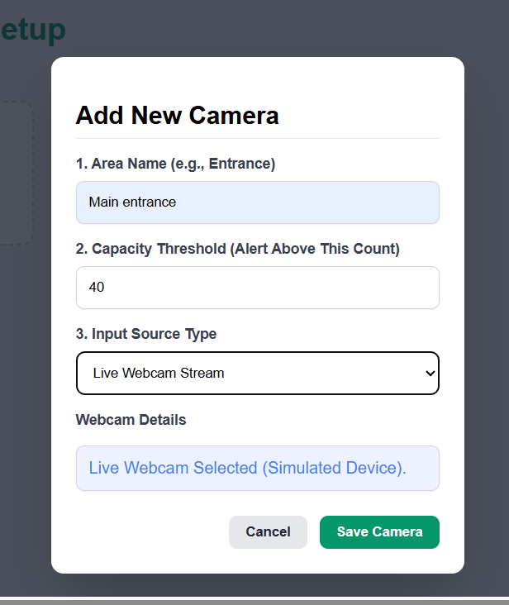
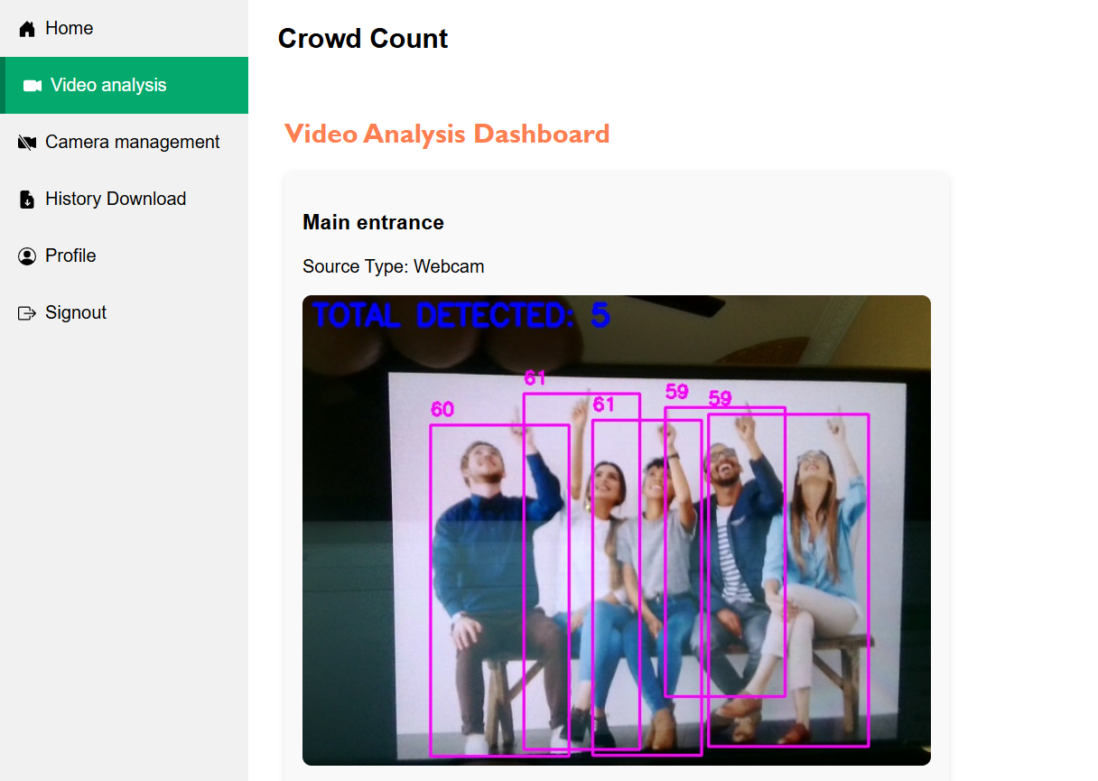
Milestone 2:
Notes:
10

Slide 12
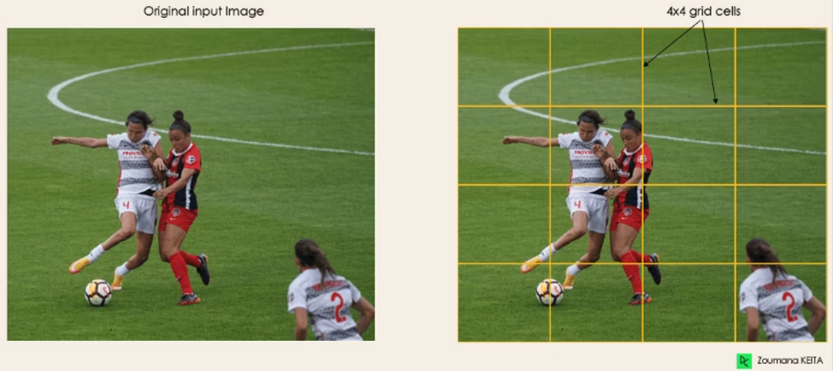
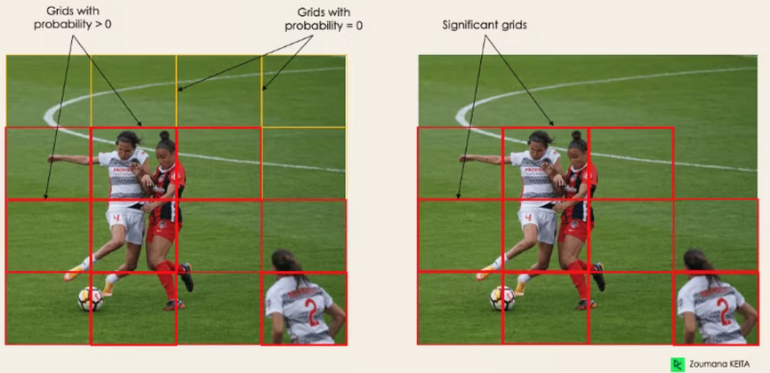
Milestone 2:
What yolo does after upload
1. Residual blocks
This first step starts by dividing the original image (A) into NxN grid cells of equal shape, where N, in our case, is 4, as shown in the image on the right. Each cell in the grid is responsible for localizing and predicting the class of the object that it covers, along with the probability/confidence value.
2. Bounding box regression
🔑 Explanation in simple sentences
pc → This number tells if there is an object in the grid cell.
If pc = 0, no object.
If pc > 0, an object is present.
c1, c2 → These are the class labels.
c1 might mean "Player".
c2 might mean "Ball".
Only one of them will be active for each box, depending on what the object is.
Notes:
11

Slide 13
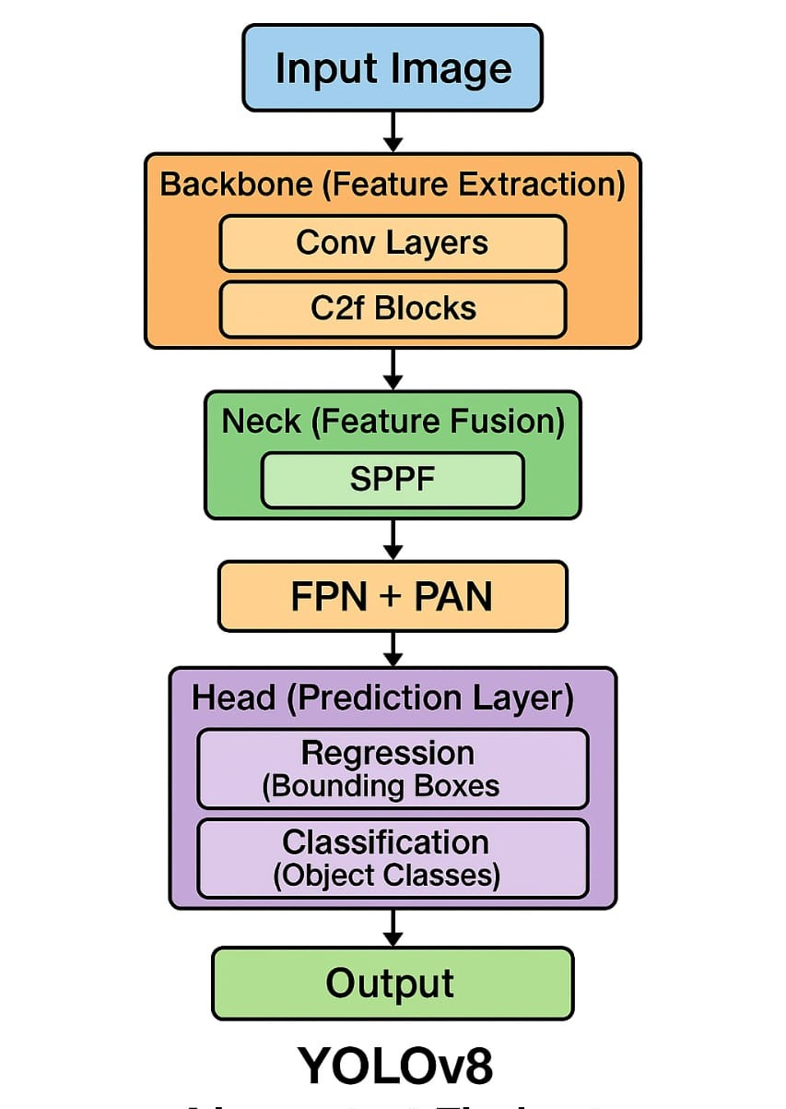
Notes:
11

Slide 14

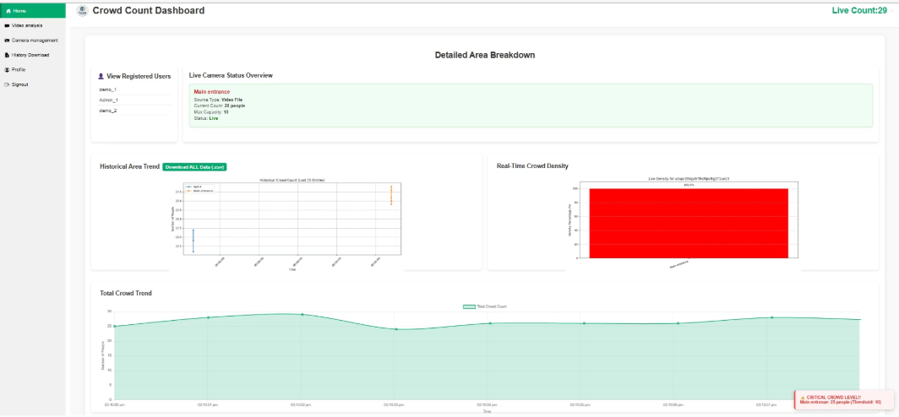


Milestone 3: Dynamic Live Analytics Dashboard
The focus of this milestone was to transform raw detection data into meaningful, visual insights through a sophisticated and responsive analytics dashboard, enabling proactive crowd management.
View Registered Users
Purpose: Provides the administrative entry point to monitor other user accounts. Selecting a user switches the dashboard to Admin View.
Visible Data: Displays a list of user IDs (demo_1, Admin_1, demo_2).
Live Camera Status Overview
Purpose: Delivers the immediate, high-level operational status of the currently selected area.
Visible Data: Displays critical, real-time metrics for the stream: Area Name (Main entrance), Source Type (Video File), Current Count (29 people), Capacity Threshold (30 people), and operational Status (Live).
Real-Time Crowd Density (Bar Graph)
Purpose: Visually represents the current load relative to the threshold, acting as an actionable density gauge.
Visual Logic: The bar shows the percentage of capacity used (29/30). The bar being completely Red indicates the count is near or at capacity, serving as an instant visual alert.
Notes:
12

Slide 15
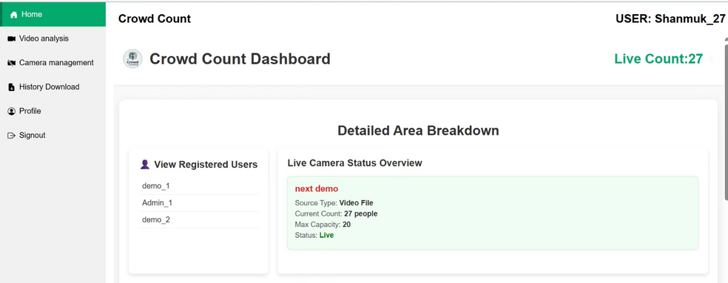
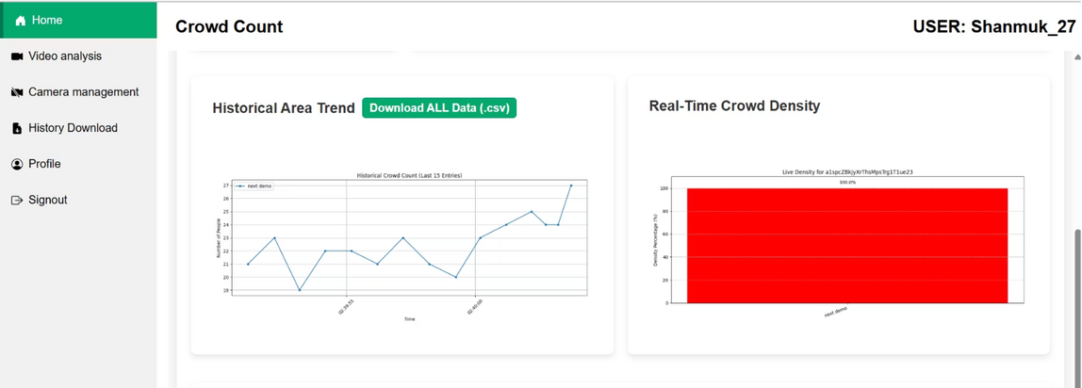
Milestone 3:
Historical Trend (Scatter Plot)
Purpose: Serves as the historical trend visualization, allowing managers to quickly assess recent count fluctuations.
Visualization: Displays a plot showing recent count points over time (a scatter plot overlaid on a connecting line).
Notes:
13

Slide 16
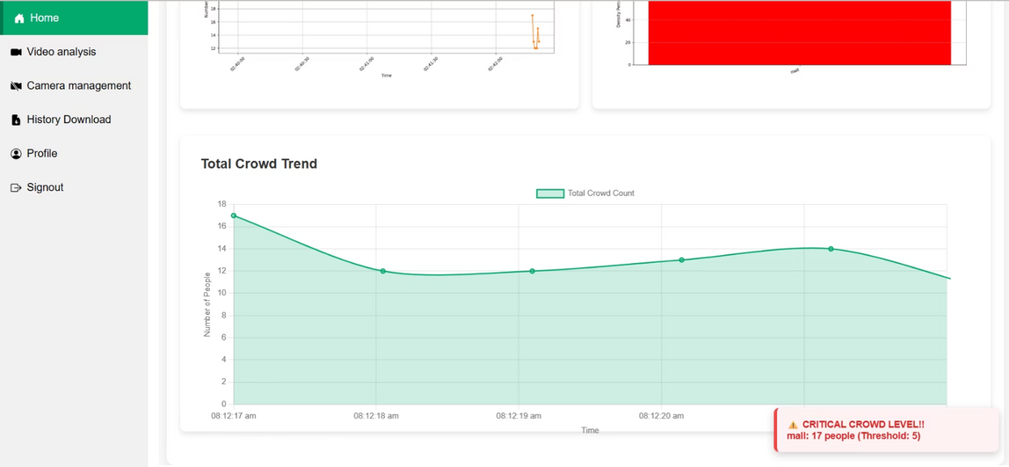
Milestone 3:
Total Area Wise Graph and Alert Feature
Total Area Wise Graph: Shows the count over a longer time scale ("Total Crowd Trend"), representing the overall usage pattern for the current user/area.
Alert Feature (Purpose): Confirms the system's ability to trigger and display an immediate, actionable alert when the capacity threshold is nearly exceeded.
Alert Display: The alert is visible as the high-priority CRITICAL CROWD LEVEL! red box in the bottom-right corner.
Notes:
14

Slide 17
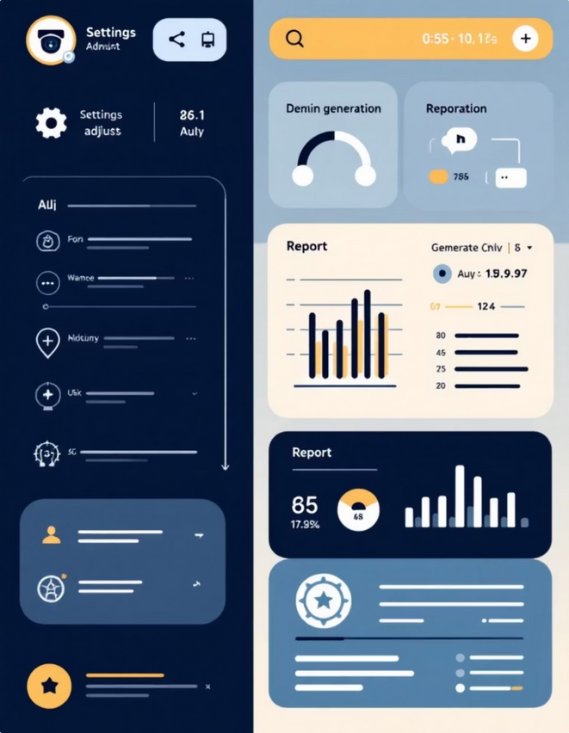
Milestone 4: Comprehensive System Control & Reporting
The final milestone adds critical administrative features, enabling full control over the system, robust reporting capabilities, and secure access management, making the system enterprise-ready.
Admin Camera Management
Introduced administrative controls for efficient management and configuration of all connected cameras.
Downloadable Reports
Enabled the generation and download of comprehensive system reports for historical analysis and compliance.
Role-Based Access
In Role-Based Access, users like Admin and Standard User get different permissions, ensuring secure and organized system access.
Notes:
15

Slide 18
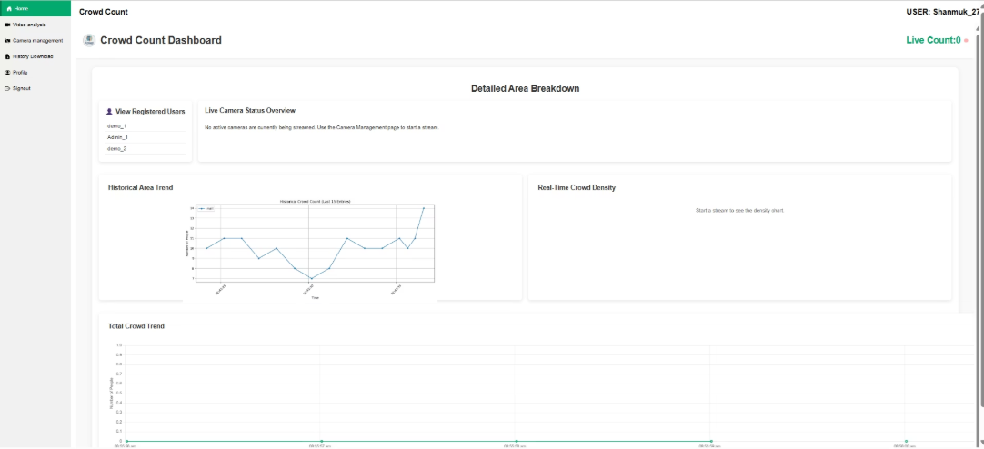
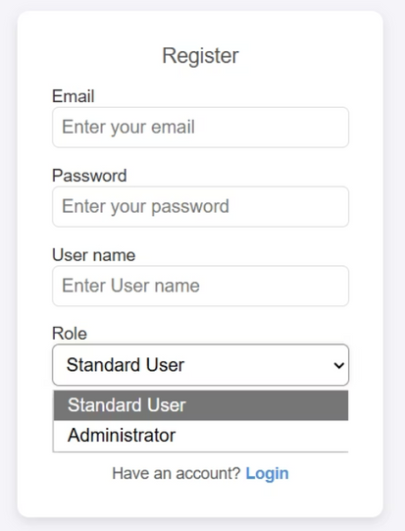
Milestone 4:
🔑 Role Selection During Registration
While registering, the user must specify their role:
User
Admin
👨‍💼 Admin (Full Access)
Has complete control over the system
Can add cameras
Can view all cameras
Can download receipts
Can view other admins' cameras and data
No restrictions (full rights)
Notes:
16

Slide 19
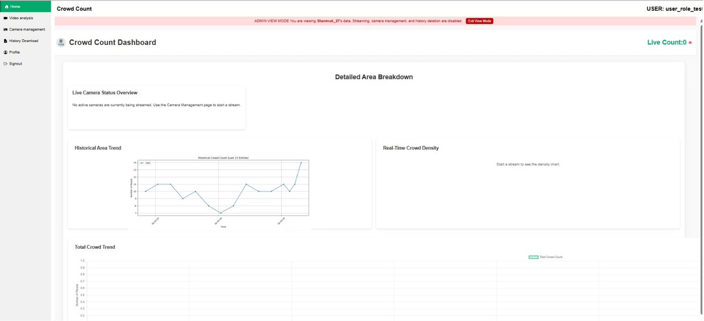
Milestone 4:
👤 User (Limited Access)
Can add cameras
Can view their own cameras
Can download receipts
Limited access to other admins' data (restricted rights)
Notes:
17

Slide 20
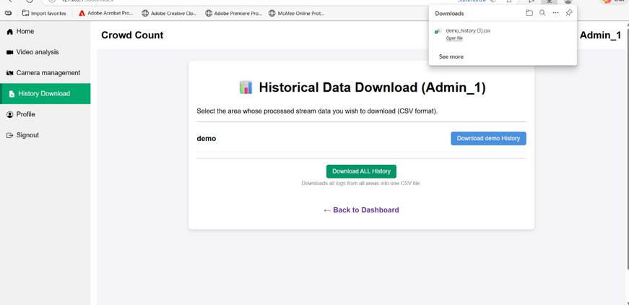
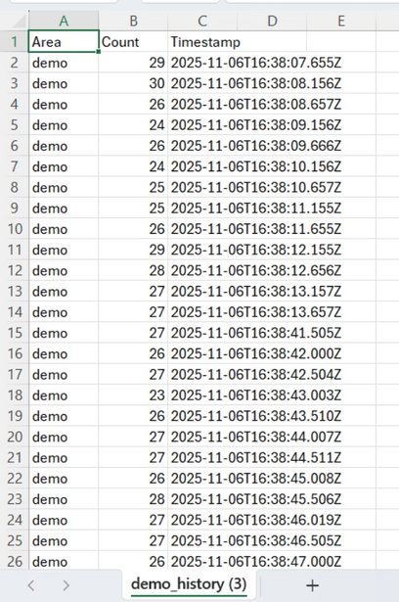
Milestone 4:
📥 CSV Download Process
Navigate to the History section
Click the Download button
The system automatically generates and downloads the CSV file
The downloaded CSV file will appear as shown in the image
👉 step-by-step flow:
Go to History
Click Download
CSV file is downloaded
File appears as shown in the image
Notes:
18

Slide 21
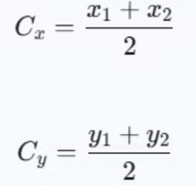
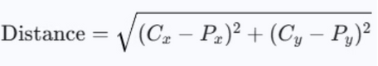
Mathematics & Formulas Behind
1. Bounding Box Center (Centroid)
This calculation localizes the center point of the detected object for tracking.
Formula Set
Context in Code
Purpose
Used in get_bbox_center to find the center point of a bounding box.
The Centroid Formulas are used to determine the center point (centroid) of the bounding box surrounding a detected person for tracking purposes.
2. Euclidean Distance (Object Tracking)
Used to measure the distance between the current detection and previously tracked objects to assign a consistent ID.
Formula Set
Context in Code
Purpose
Used in continuous_video_analysis to calculate the distance between a newly detected centroid and previously tracked object centroids.
The Distance Formula is applied to calculate the Euclidean distance between current and previous centroids, enabling robust object tracking across video frames.
Notes:
19

Slide 22

Mathematics & Formulas Behind
3. Area of Interest (AOI) Line Check
Used to determine if the object's centroid is counted (i.e., below the defined line).
Formula Set
Context in Code
Purpose
Used in is_in_aoi_below_line to define the Area of Interest (AOI).
The Slope (M) and Y-intercept (B) Formulas define the linear equation of the Area of Interest (AOI) boundary line set by the user for calculating density within a specific region.
Notes:
20

Slide 23


Conclusion: Intelligent Crowd Monitoring for the Future
The People Counting and Zone Management System represents a significant leap forward in automated public space monitoring. By harnessing the power of computer vision and deep learning, it delivers an unparalleled level of accuracy and efficiency.
Enhanced Security
Real-time insights empower rapid response to crowd anomalies and potential security threats.
Optimized Operations
Data-driven decisions lead to improved resource allocation and operational efficiency in various environments.
Scalable & Adaptable
Designed for deployment in diverse public environments, from airports and malls to parks and event venues.
Future-Proof Solution
A robust foundation for future enhancements and integrations, ensuring long-term applicability.
This system is ready to revolutionize how we manage and understand crowd dynamics, contributing to safer, smarter, and more efficient public spaces.
Notes:
21

Slide 24

Implementation :
Retail & Commercial Spaces: Monitor foot traffic in malls, queues at checkout, and hot zones in large stores for business intelligence and layout optimization.
Transportation Hubs: Manage congestion at airport security, boarding gates, and railway platforms to ensure safety and smooth passenger flow.
Events & Public Safety: Enforce strict occupancy limits (using your capacityThreshold) at stadiums, concerts, and festivals to prevent overcrowding and manage emergency evacuations.
Institutional & Corporate Campuses: Track usage of common areas (libraries, cafeterias) and monitor access to restricted industrial zones for safety and resource allocation.
Smart Cities: Collect data on pedestrian movement in public squares and on sidewalks for urban planning and infrastructure development.
Notes:
22

Slide 25
Thank You
Notes:
23

